Slide 1
Ch 2.1
Machine Learning: Definition and Applications
Notes:
welcome to machine learning.
what is machine learning you probably use it many times a day without even knowing it. Anytime you want to find out something like how do I make a sushi roll, you can do a web search on Google or Bing to find out, and that works so well because they're machine learning software has figured out how to rank web pages. When you upload pictures to Instagram or Snapchat and think to yourself I want to tag my friends so they can see their pictures, well these apps can recognize your friends and your pictures and label them as well. That's also machine learning. or if you've just finished watching a Star Wars movie on a video streaming service and you think what are the similar movies could I watch, well the streaming service will likely use machine learning to recommend something that you might like. Each time you use voice to text on your phone to write a text message hey Andrew how's it going or tell your phone hey Siri play a song by Rihanna or ask your other phone okay Google show me Indian restaurants near me that's also machine learning each time you receive an email titles congratulations you've won a million dollars well Libya Rich congratulations or more likely your email service will probably fly good as spam that too is an application of machine learning Beyond consumer applications that you might use AI is also rapidly making its way into big companies and into industrial applications for example I'm deeply concerned about climate change and I'm glad to see that
machine learning is already hoping to optimize wind turbine power generation or in healthcare is starting to make its way into hospitals to help doctors make accurate diagnoses or recently at Landing AI I've been
doing a lot of work putting computer vision into factories to help inspect if
something coming off the assembly line as any defects that's machine learning it's a science of getting computers to learn without being explicitly programmed in this class you learn about machine learning and get to implement machine learning in code yourself millions of others have taken the earlier version of this course which is a course that led to the founding of
Coursera and many Learners ended up building exciting machine learning
systems or even pursuing very successful careers in AI I'm excited that you're on this journey with me welcome and let’s
get started

Slide 2
Content
What machine learning means
How machines learn from data
Why machine learning is important
Types of machine learning
Common applications of machine learning
The impact of machine learning on different fields
Key ideas and conclusion

Slide 3
Unvelling the Magic of ML

Slide 4
Definition of Machine learning
“Field of study that gives computers the ability to learn without being explicitly programmed.”
Arthur Samuel (1959)

Slide 5
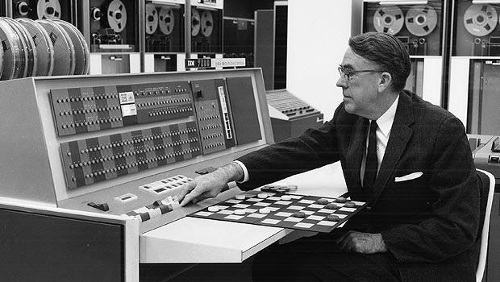
The Impact of Learning Volume
The more chances a learning algorithm has to practice, the better it becomes.
Samuel’s checkers program improved because it played a very large number of games against itself.
He programmed the computer to play thousands of self-play games, learning from each outcome.
Over time, the program became stronger and eventually outperformed Samuel himself.

Slide 6

Question
If the checkers program had been allowed to play only ten games (instead of tens of thousands) against itself, a much smaller number of games, how would this have affected its performance?
Would have made it better Would have made it worse

Slide 7
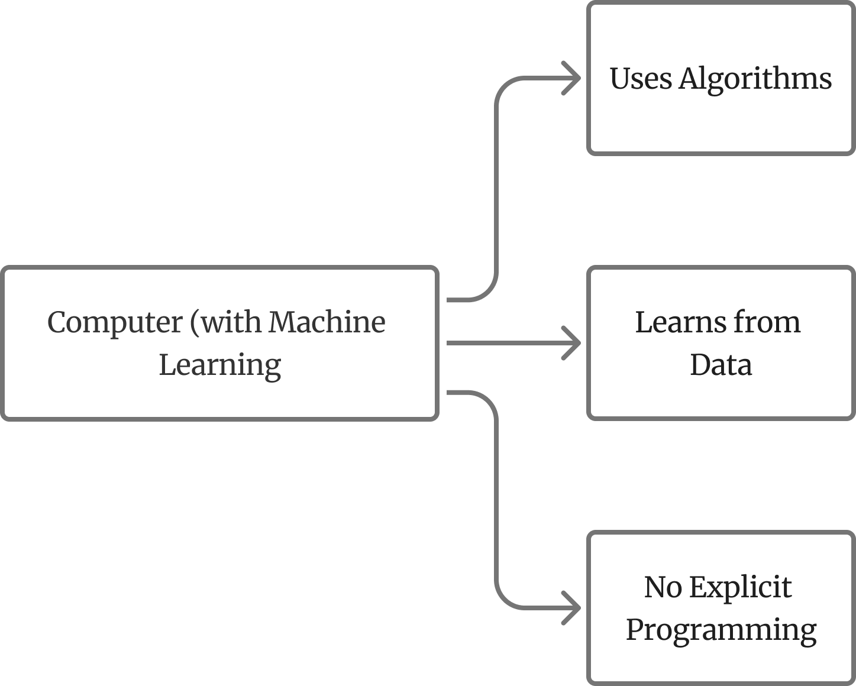
What is Machine Learning?
Machine learning is a field of AI that lets computers learn from data and improve performance without being explicitly programmed
It uses algorithms to find patterns, make predictions, and support decision-making.

Slide 8
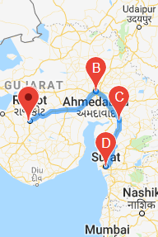
The Significance of Machine Learning:
Many real-world tasks are too complex to code with fixed rules.
Machine learning replaces manual programming by learning patterns automatically from data.
This makes it a powerful approach for building intelligent systems.
Machine learning does what coding can’t—it learns the rules instead of needing them written.

Slide 9
Examples of tasks that are hard to program
Web searches,
Speech recognition,
Medical diagnosis from x-rays,
Developing self-driving cars.
Speech recognition,
Computer vision for google maps street view images,
Advertising.
Large scale agriculture
→ The solution of all of these tasks is machine learning

Slide 10
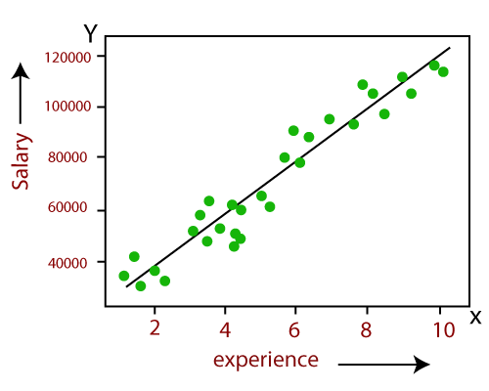
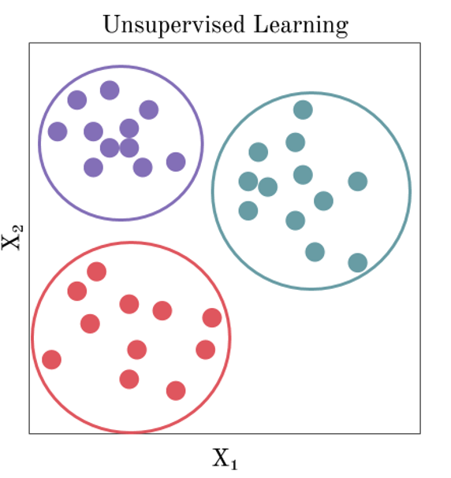
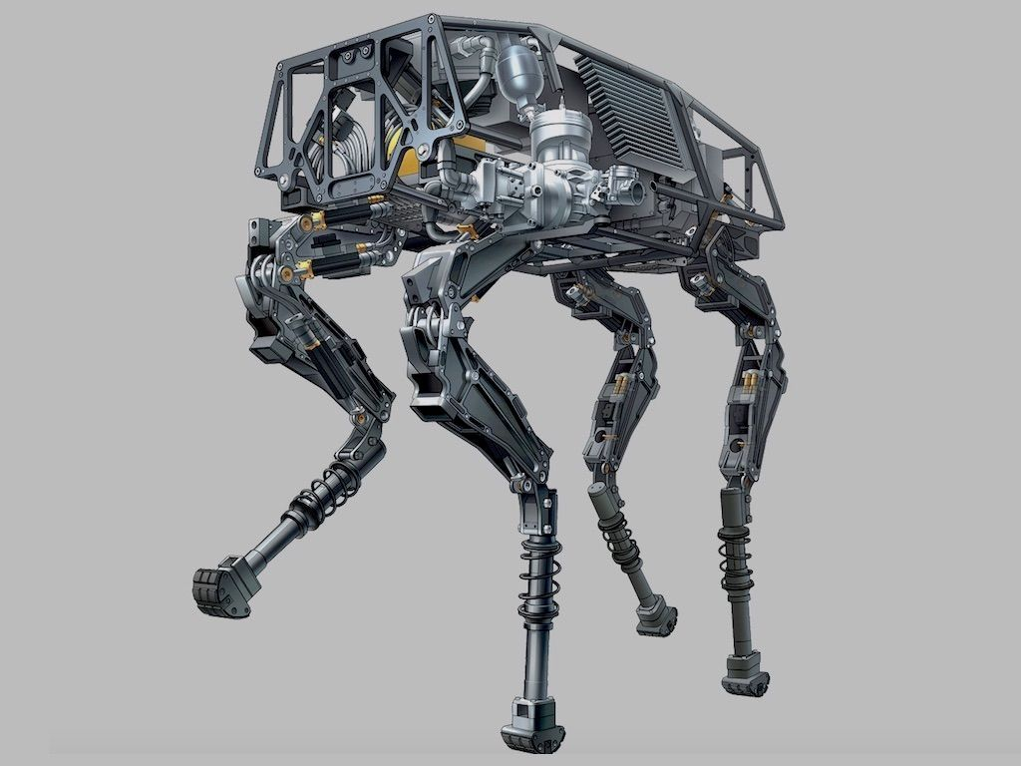
Types of Machine Learning
Supervised Learning
Unsupervised Learning
Reinforcement Learning

Slide 11
Supervised Learning
Experience (years) | Salary (USD)
2 | 40,000
3 | 48,000
4 | 55,000
5 | 62,000
6 | 70,000
7 | 78,000
8 | 90,000
9 | 105,000
10 | 118,000
Supervised learning trains a model using labeled examples—like experience paired with salary—so it can learn the relationship and predict salaries for new experience values.

Slide 12
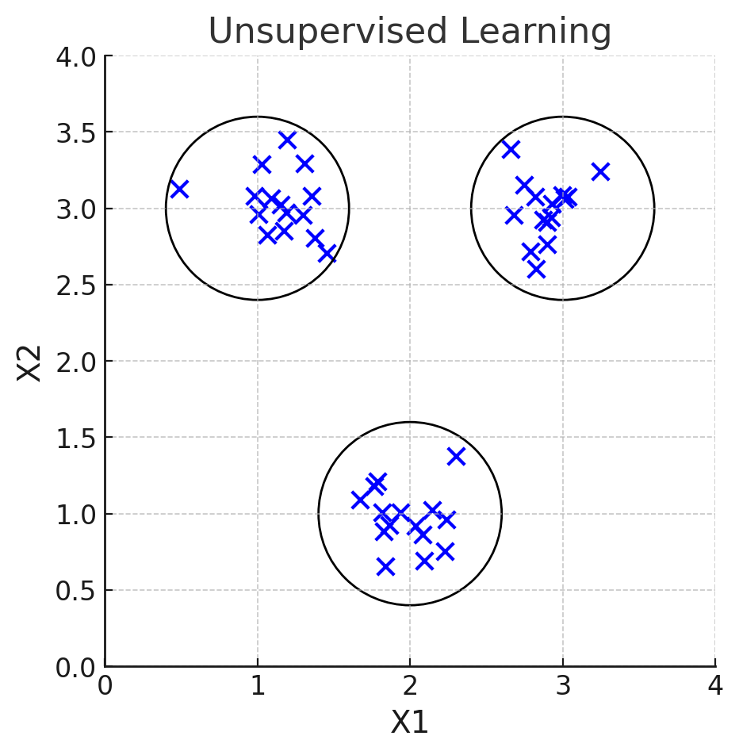
Unsupervised Learning
Unsupervised learning, on the other hand, focuses on finding inherent structures or patterns within data without the assistance of labeled information.
For instance, it can group customers with similar purchasing behaviors in e-commerce, helping businesses offer more targeted recommendations.

Slide 13
Reinforcement Learning
Reinforcement learning involves training agents to make a sequence of decisions in a dynamic environment.
It's like teaching a robot to navigate a complex maze or a game character to make optimal moves. The agent learns by receiving rewards or penalties for its actions, gradually improving its decision-making process.

Slide 14
Applications of Machine Learning
Image and Speech Recognition
Examples: Facial recognition, voice assistants
Natural Language Processing (NLP)
Examples: Chatbots, language translation, sentiment analysis
Recommendation Systems
Examples: Product recommendations, movie suggestions
Autonomous Vehicles
Examples: Self-driving cars, autonomous drones
Healthcare and Medical Diagnosing
Examples: Disease detection, personalized treatment, drug discovery

Slide 15
Unlocking Value of Machine Learning:
AI and ML are expected to add $13 trillion USD in value by 2030.
Rapid global growth driven by generative AI and automation.
ML is expanding beyond software into healthcare, finance, retail, energy, and transportation.
Countries and companies are investing heavily in AI adoption.
Demand for ML talent is rising fast—making now the best time to learn ML.

Slide 16
Conclusion
Machine learning is not just a buzzword but a transformative technology with applications in numerous domains.
It empowers computers to handle complex tasks, make accurate predictions, and unlock the potential of data-driven decision-making. As we continue to advance in this field, the possibilities are endless.

